Slide 1
The Dust Bowl
Lessons of the Past
Informing the Present
Shaping the Future

Slide 2
On the Move
1 With your group, brainstorm as many reasons why people move as you can placing each reason on a separate sticky/post-it note.
2 As a team, you will consider each reason for moving and sort them into two categories: those reasons that would force you to move and those that would help you make the choice to move.
Forced
Choice
3 Choose a group member to post your reasons in the forced category on the board and another member to do the same for the choice category as seen on the graphic on the right.

Slide 3
On the Move 2
1 After hearing the reason for the placement of each post, are there any that your group thinks to be miscategorized? Make your case to the class to have it moved. Majority rules.
Forced
Choice
2 As a group, decide why you were asked to sort your reasons into these 2 categories. Pick a spokesperson to share your group’s reasoning with the class.
3 Read the following definitions, note that forced = refugee and choice=migrant then decide as a group which type of movement is more of a concern for individuals and governments in both in the US and globally. Why?
ref-u-gee
A person who has been forced to leave their country in order to escape war, persecution, or natural disaster. (https://www.google.com/?gws_rd=ssl#q=refugee+definition)
mi-grant
A migrant is a person who makes a conscious choice to leave their country to seek a better life elsewhere. (http://www.ssi.org.au/faqs/refugee-faqs/148-what-is-the-difference-between-a-refugee-and-a-migrant)

Slide 4
Current and Future Climate Refugee Crises.
On the Move 3
1 Annotate the linked article below using the code provided as you read.
2 Use the sentence starters provided to write at least one sentence in each of the four categories found in columns below the code.
3 Share your 4 sentences with your shoulder partner. Choose your partner’s best sentence to share with the class. Can the 4 of you think of any situations in the past that could help us understand this problem and perhaps help us deal with it today?

Slide 5
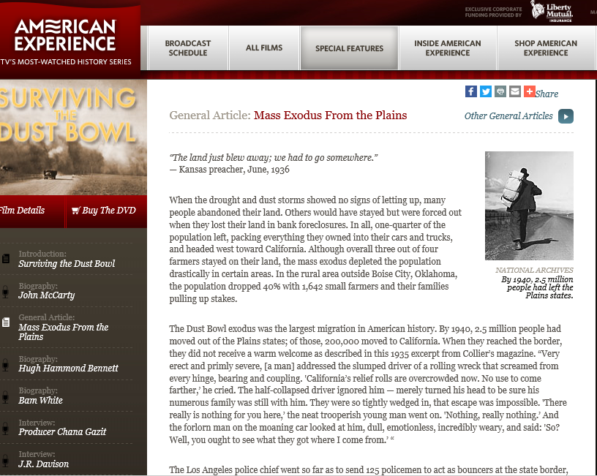
Climate Refugees in US History
On the Move 4
3 Step one: Compare answers from both charts and circle your 3 most important facts, 2 best questions & strongest opinion to share with another group. Step two: Share your selections with another group and repeat step one. Step three: Select three group members to post your best of the best in each category.
1 As you actively view the linked video that introduces the Dust Bowl to the class, work with your partner to complete the 3-2-1 chart.
2 Click on the graphic and partner read “Mass Exodus From the Plains” and complete a 3-2-1 chart with different answers than you used in the video chart.

Slide 6
Lab Directions: Dust Bowl
You will further explore different aspects of the Dust Bowl and the implications for those affected by the extreme environmental conditions as you rotate through the different stations in this lab.
Stay at your assigned station until directed to rotate. Do your best to complete the assigned tasks. Fill in your lab report sheet as you go and remember to post your stay or go status at each station. (see next slide)
Feel free to discuss ideas within your group.
You will have approximately 20 minutes to work at each station.

Slide 7
Should You Stay or Should You Go?
At each of the following stations you will write your opinion and one reason/support on your post-it note.
When you are ready… add your post-it note in the appropriate place on the station’s opinion spectrum before moving to the next station.
Move
Stay
Away
Home
Notes:
Lesson Hook: Introduction

Slide 8
Station One: Dust Storms
3 Listen to the interview of a dust storm survivor from the Library of Congress by clicking the logo below.
1 Watch the video: “The Great Dust Storm” by clicking the picture below.
4 Have a team discussion about and sketch the following:
What would you do to prepare for a dust storm where you live?
What might things look like around the school after a modern day dust storm.
Sketch your post dust storm vision.
2 Read the description of a dust storm from chapter 1 of Grapes of Wrath by John Steinbeck. Begin reading at “The wind grew stronger…”

Slide 9
Station Two: Looks Kinda Promising Out West...
Click on any label or poster for a full-sized image
4 Discuss within your group what messages the fruit companies are trying to convey to customers?
How might these labels entice people to move west? Do the employment posters and the labels together add to the lure of the west?
1 Look carefully at the fruit crate labels and consider the imagery used in them
3 Examine the employment handbills remembering what conditions are like in the dust bowl
2 Click on the book cover and read the description of California found in Ch. 18 (p.154) starting with “They drove through..” ending with “California.”
5 Design a label for a local product that would draw people to your city or town.

Slide 10
Station Three: Western Realities
2Watch the video below about the treatment of “Okies” in California.
1 Click the logos below to listen to the songs Sunny Cal & Arizona
Sunny Cal
Arizona
3 Click on the logo below and read the Steinbeck piece “Starvation Under the Orange Trees” and summarize the article according to the checklist provided.

Slide 11
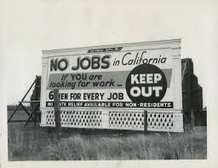
Station Four: What’s America About Again?
3 Study theses images. Why these photos?
1 Read the poem New Colossus by Emma Lazarus found by clicking the blue button below
2 Click the symbol below and read “Bum Barricades”.
The 5 smaller images can be enlarged by clicking on them.
4 Discuss with your group the messages of the poem, article and photos and how they compliment and contradict each other at the same time. Which of these messages do you think represents what people thought in the US of the 1930s? Why?

Slide 12
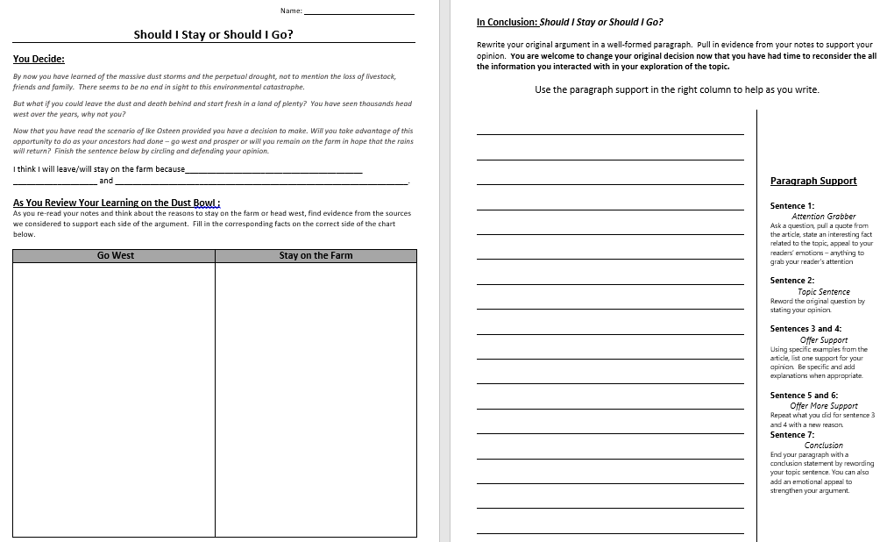
Station Five: Decision Time
2 Use the organizational sheet below to help you formulate a coherent, well-reasoned paragraph in which you support your answer to whether you would have remained in the dust bowl region or you would have headed west for a fresh start.
1 Read the scenario in the “Hook Exercise” found on page 2 in the DBQ project’s Mini-Q linked below

Slide 13
Station Six: Life Interrupted
2 Read “My Life Interrupted” by Esau Sinnok linked below.
1 Listen to the NPR interview teenager Esau Sinnok of Shismaref, AK discussing how he and his fellow villagers voted whether to stay in their village or relocate because of the changing environmental conditions
2-Bit Answers
4 We all know that words are worth a penny a piece these days and since times were tough during the dust bowl all you can afford to spend on each answer is a quarter. So, please answer the questions regarding the information in this page where indicated on the lab sheet completely and within your budget.
3 Read the linked New York Times Article about the decision whether to move Shishmaref, AK.

Slide 14
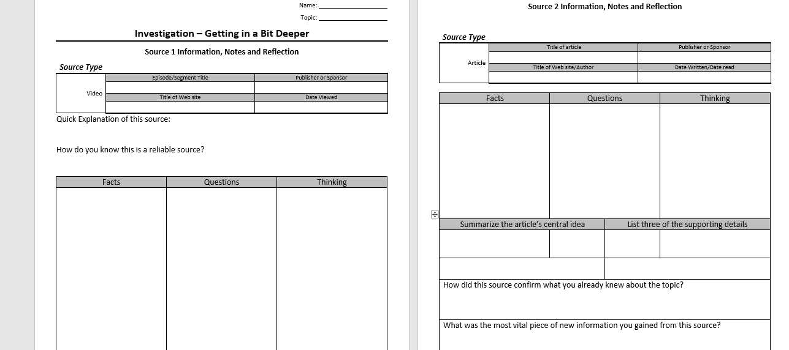
Station 7: A Deeper Dive
Example :
Rising Sea Levels
1 Select a current environmental topic or situation that could force people to move from their current homes to research a bit deeper.
2 Find at least 3 reliable sources and complete the research guides on each source.
Example:
Desertification
3 Choose a format that you will use to present your findings to the public

